Slide 1
amazon

Slide 2
01
Introduction
02
Dataset Overview
Contents
03
Feature Engineering
04
Exploratory Data Analysis (EDA)
05
Application Overview
06
Q/A

Slide 3
Introduction
Getting sales insights is transformative for Amazon sellers, as it allows them to understand customer behavior, optimize product offerings, and make data-driven decisions that can significantly boost sales and profitability. Here’s a breakdown of how sales insights impact an Amazon business:

Slide 4
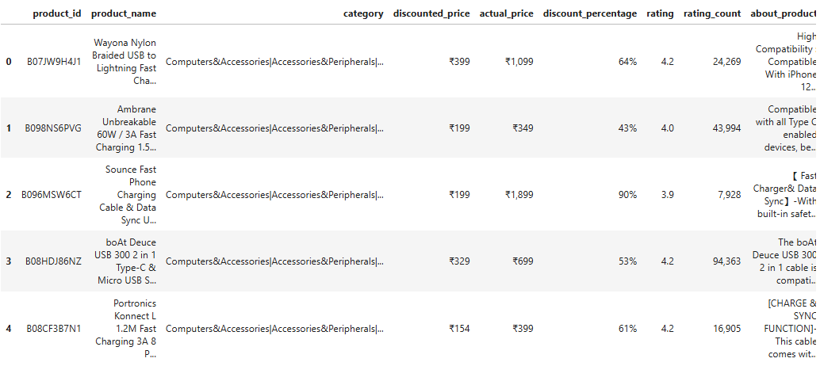
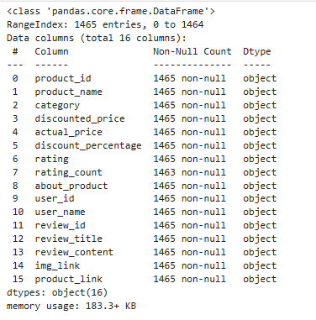
Dataset Overview
Here we will have a quick overview on our data:
Dataset Features and Observations
Null Values
Datatypes

Slide 5
Feature Engineering
We will find that there are some Categorical data need to be converted to Quantative data by removing symbols, split values, change Dtype , Removing NaN values.
Here we will go through some data cleaning by removing symbols and changing data types
Splitting the category column must be done to figure out the category and subcategory of Items

Slide 6
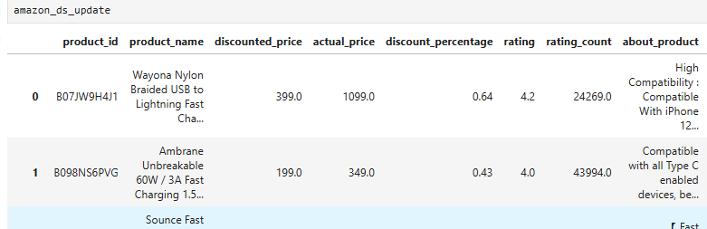
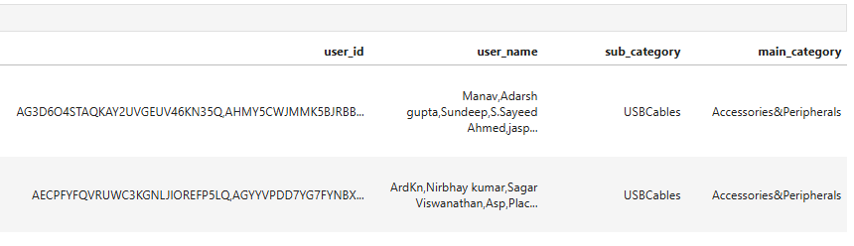
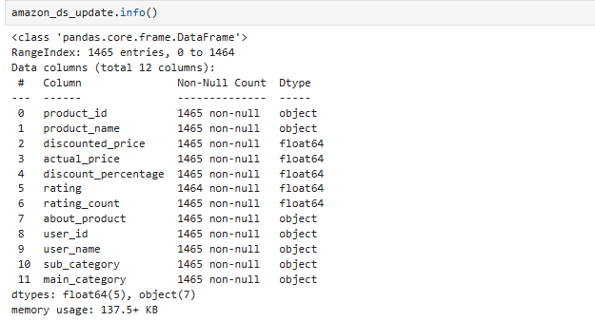
Feature Engineering
After the preparation of the dataset, we will find the new dataset shape
Removed all unnecessary symbols
We will find the new columns added
Main_Category
Sub_Category
Updated necessary Dtypes

Slide 7
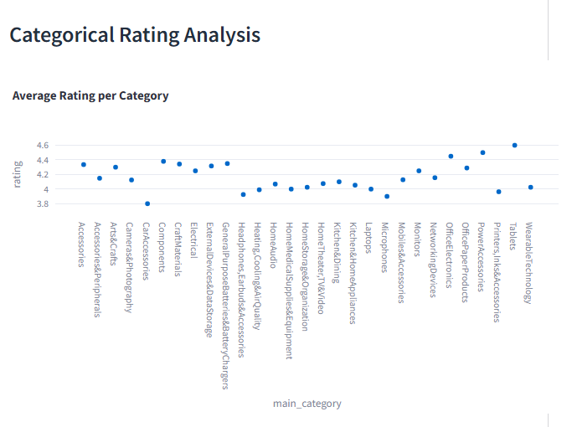
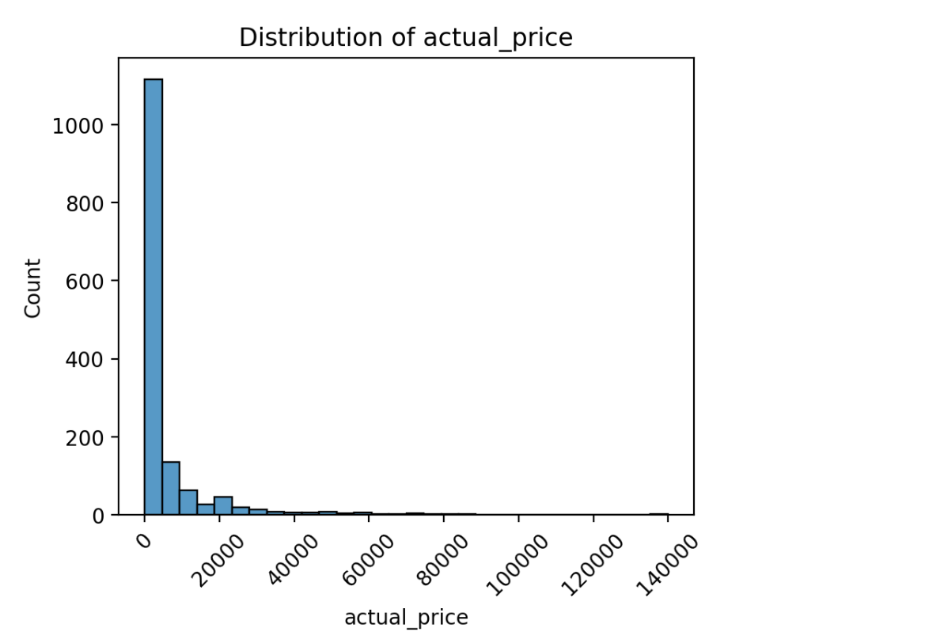
Exploratory Data Analysis (EDA)
Uni-Variate Analysis
Bi-Variate Analysis

Slide 8

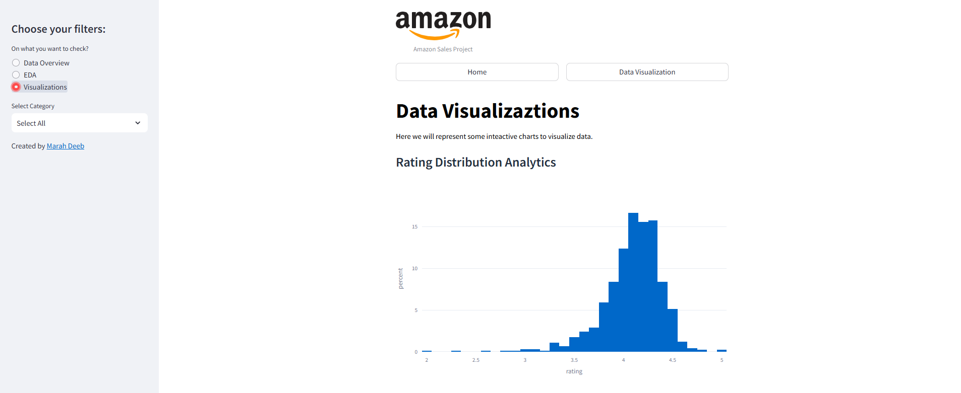
Application Overview
Let’s Go through our application through the following URL:
Amazon App

Slide 9
Any Questions?

Slide 10
thanks!

